Slide 1
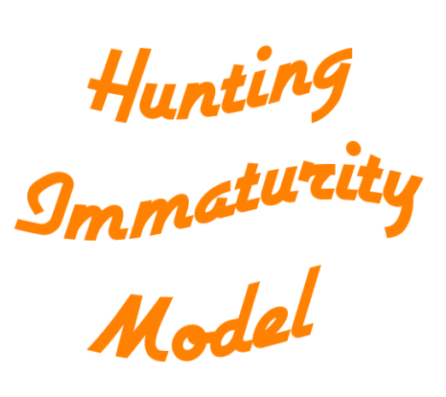
a parody of hunting maturity model
Presentation by @tas_kmanager

Slide 2



net user @tas_kmanager
Mangatas (Tas) Tondang
Threat Hunter
Major Canadian Telecom/ISP/Technology company
Threat Hunting, Research and Detection
Threat Intelligence
DFIR
Automation
Astrophotography, Cooking & Music when AFK
Twitter @tas_kmanager
LinkedIn /tondangmangatas/
GitHub /tas-kmanager/
Notes:
02:00

Slide 3
Disclaimer!
The views, thoughts, and opinions expressed in this presentation belong solely to the author, and not necessarily to the author's employer, organization, committee or other group/individual

Slide 4

findstr “directory”
Hunting Maturity Model (HMM)
What?
Why?
Hunting Immaturity Model (HIM)
What?
Why?
HIM Levels In Details
HIM 0
HIM -1
HIM -2
HIM -3
HIM -4

Slide 5
Disclaimer! (Again)
Although this talk is a parody of Hunting Maturity Model (HMM), there’s no intention to make fun of HMM. In fact this talk will show why HMM is a good metric to follow!

Slide 6
Hunting Maturity Model (HMM)
Notes:
02:30

Slide 7

What is HMM?
“The Hunting Maturity Model (HMM) … describes five levels of organizational hunting capability, ranging from HMM0 (the least capable) to HMM4 (the most)”

Slide 8
Based on certain Focus Points
Data Collection Capability
Hypothesis Creation
Hunt Tools and Technique
Pattern and TTP Detection Mechanism
Analytics Automation

Slide 9
5 Stages of HMM

Slide 10
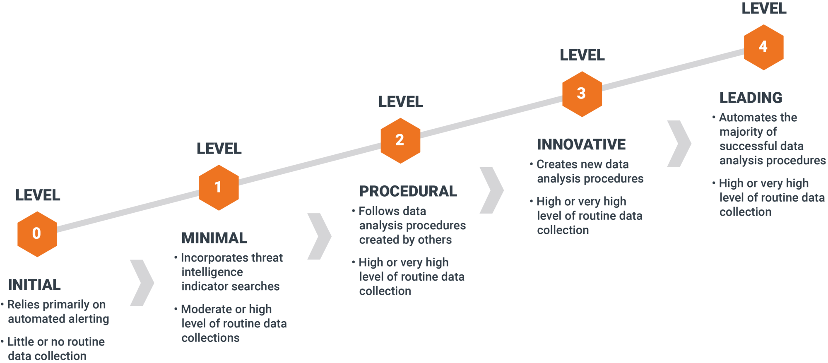

Slide 11
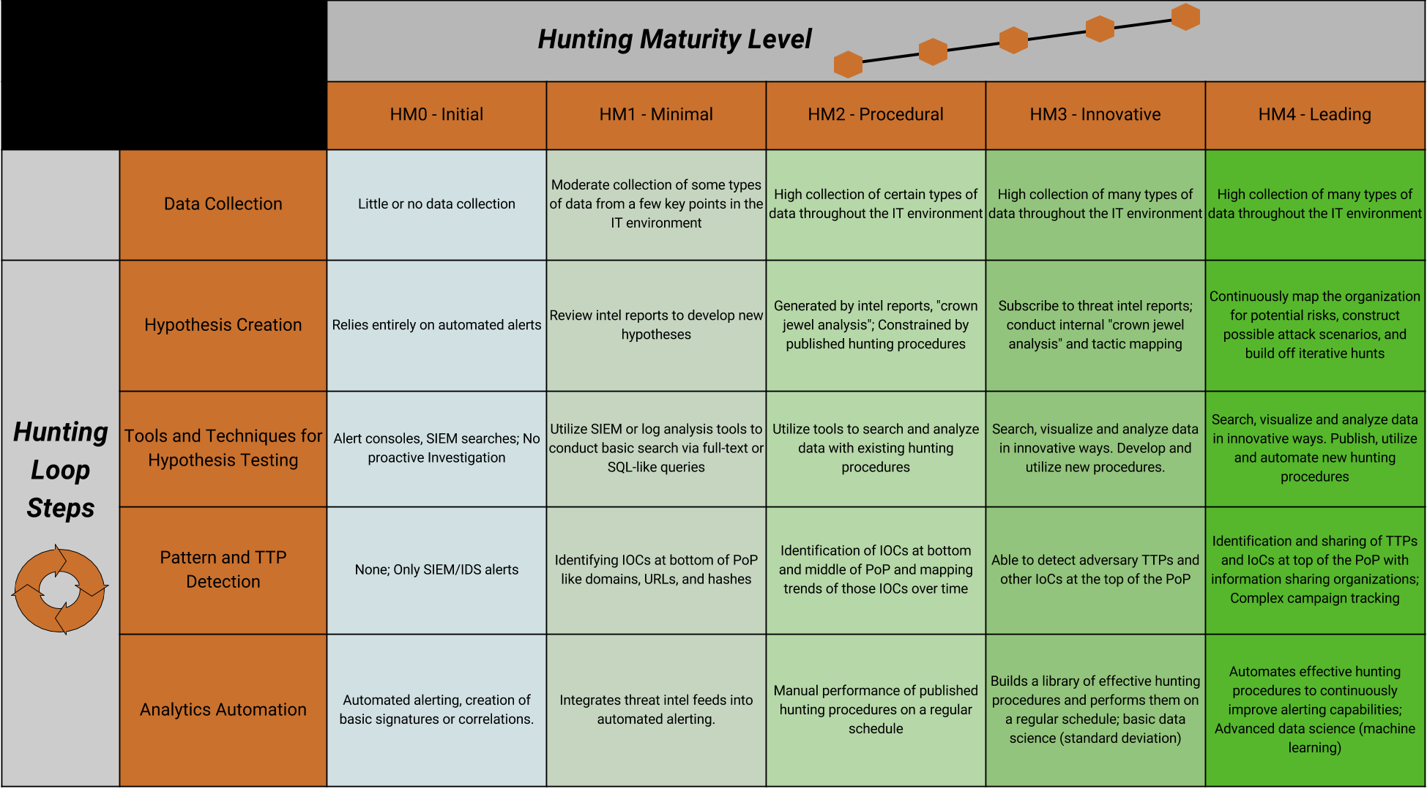

Slide 12
Why use HMM?
“can give organizations a more granular view as to what parts of the hunting process they still need to be improving to reach the next stage of hunting maturity”

Slide 13
Example of Improvements
Data Source Gap Analysis
Hunt Ideas Sources
Tools Acquisition
Detection Gap Analysis
Analytics Acquisition
Notes:
05:00
Don’t talk too much details here

Slide 14
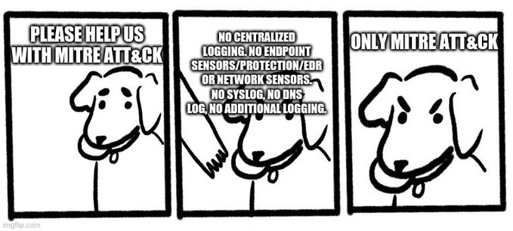
what goes up
must comes down
How to not Threat Hunt
Credits: @fouroctets
Notes:
Just like life what

Slide 15
Not all of Threat Hunting is fun and easy!
I asked numerous Threat Hunting practitioners what are some of the challenges that they faced/are facing in the Threat Hunting world (including Detection Engineering)
You’ll probably familiar with some of these names!

Slide 16


“Too much confidence in you own detection (aka lack of periodic logic review of all existing detections and hunts)”
“Not everyone security person is a good Threat Hunter. You need certain traits to be a good hunter”
“Even if you agree on the definition, many people misunderstand the purpose of threat hunting”
“Simply not having some sort of feedback loop to learn and improve”
“Building a team because it’s a buzzword and equip it with people that want to do it because it seems cool”
more details on appendix

Slide 17
Hunting Immaturity Model (HIM)

Slide 18
What is HIM?
“The Hunting Immaturity Model (HIM) is the long lost brother of HMM. This model will instead provide the common mistakes hunt teams or their management made and it will be divided in to five several levels,
just like HMM”

Slide 19
Based on certain Focus Points
Dedicated Personnel
Management Understanding of Threat Hunting
Hunt Organization, Planning and Prioritization Capability
Integration with the rest of Organization's Security body
Continuous Improvement, Deployment and Learning

Slide 20
5 Stages of HIM

Slide 21
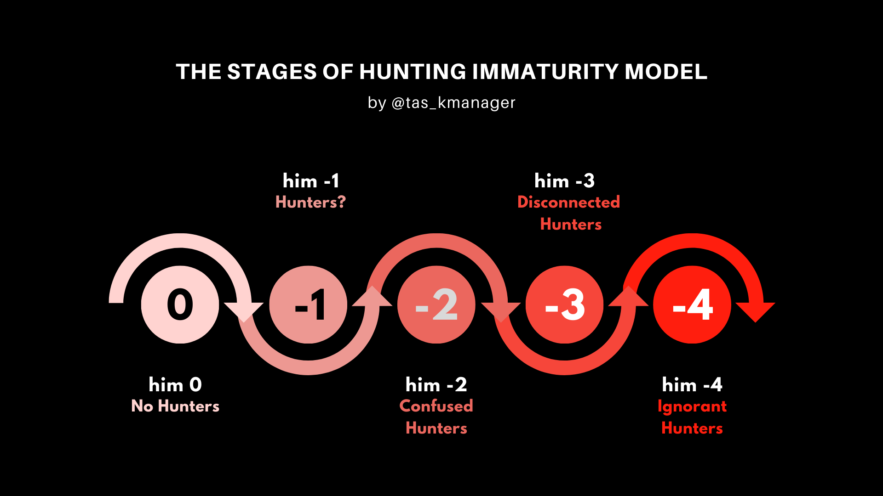

Slide 22
Why use HIM?
These are real mistakes occurred in real organizations. You can use this model to avoid actually making the mistakes itself. Alternatively, you can see if your organization is doing these mistakes and pull yourself out of it before it’s too late!

Slide 23
Learn common mistakes in areas such as:
Management Understanding of Threat Hunting
Hunt Organization, Planning and Prioritization Capability
Integration with the rest of Organization's Security body
Continuous Improvement, Deployment and Learning
And avoid it!

Slide 24
HIM Levels In Details

Slide 25
HIM 0
No Hunters

Slide 26
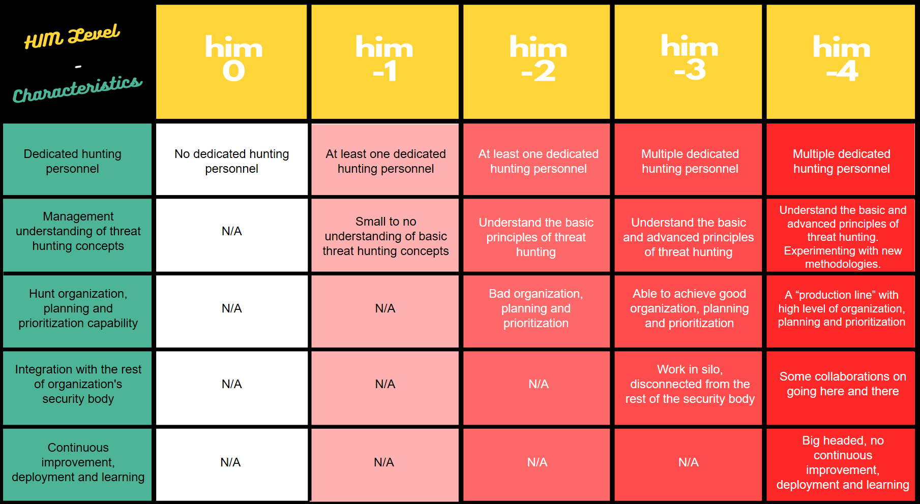
Who are they?
Relatively new SOC or Security Body in the organization
Other priorities, hunting is not in picture yet (completely fine!)
Focus on other topics such as hiring the right people, conducting analysts training, creating Incident Response SOPs, infrastructure architecture, or on boarding logs/data sources.
Relies heavily on what vendors provided
Learning how to use the vendor tools and establishing procedure for each tools

Slide 27
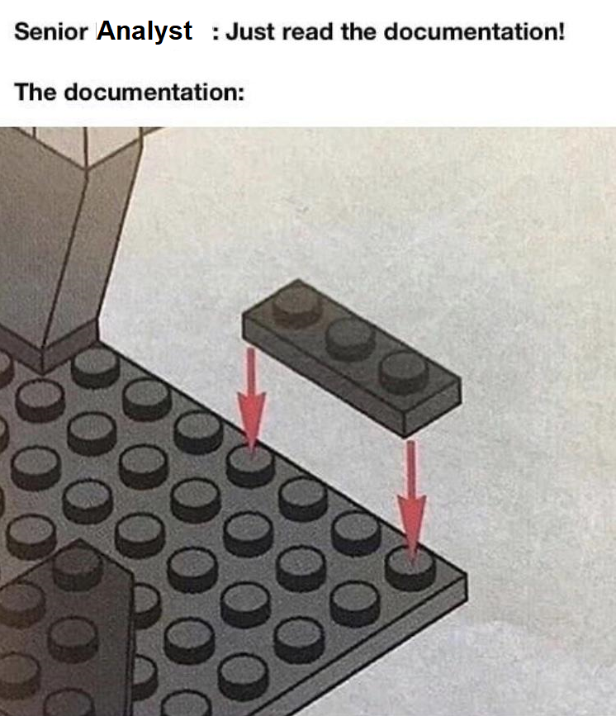
Getting out of HIM 0 (to HMM 1)
Take some time!
Threat Hunting is not intended for newly formed Security body or SOC
Focus on preparing Threat Hunting capability
Logging capability from MITRE ATT&CK
Documented security infrastructure
Assets management
Having people that understand your organization network and architecture
Create and document GOOD Incident Response process
Analyst that understand every single step of Incident Response the process
Most of the time, the first threat hunter is an ex-analyst

Slide 28
HIM -1
Hunters?

Slide 29
Who are they?
Organization have at least one threat hunting member - at least on their position title ;)
The reason behind hiring the person is often because of the hype of the “threat hunting” buzz words (just like AI, SOAR, E/XDR you named it)
Often the organization is not ready for Threat Hunting itself
No proper consumer, which is SOC 24/7 monitoring
No logging capability inside the organization, even dispersed logging
Tons of expensive security tools with bad configuration
No infrastructure and engineering team to help Threat Hunting operation

Slide 30
Do they even know what Threat Hunting is?
No! They have little to no understanding of what threat hunting actually is
Mistaken what a threat hunting role is!
Common assignment mistakes such as:
Threat Hunter performing Threat Intel work all the time
Threat Hunter acting as SOC’s L3/L4, majority working on Incident Response while sometimes performing hunts
Threat Hunter but working more on tuning vendor tools, their work is more in engineering side than the hunting/research side

Slide 31
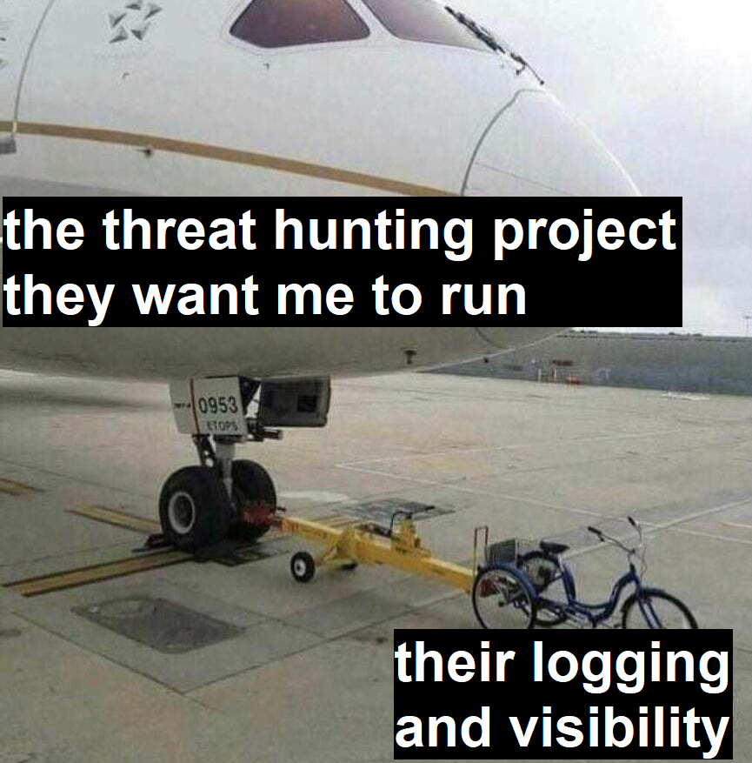
Getting out of HIM -1
Don’t jump to the Threat Hunting boat too quick!
Be a mature SOC first and then start thinking about building a Threat Hunting team
Promote your best Analyst to be your first ever Threat Hunter!
Prepare your infrastructure and tools for Threat Hunting operation
Inform yourself on Threat Hunting practices
Threat Hunting case study or presentation (there’s million of them, literally!)
Use common frameworks to start Threat Hunting such as HMM, hunting cycle or pyramid of pain.
Ask for help when needed, either from community, hire seasoned TH team leader, or pay Consulting firms to do the job!

Slide 32
HIM -2
Confused hunters

Slide 33
Who are they?
Have dedicated personnel(s), with the right tasks and skill set
Management understand the Threat Hunting role and requirements
But!
Although their position are dedicated they are disorganized, the hunters still perform ad-hoc like hunting operation
No structured process to be followed – each member have their own way
No clear goal of hunting (creating detection? gap analysis? etc.)
No documentation on hunting that has been completed
Consequences? Different members might perform the same hunt because of disorganization!
Or worst, same member perform the same hunt twice…

Slide 34
Planning and Prioritization
Limited to no planning and prioritization
Not following any framework for coverage planning
Coverage framework will help you set your goal and to plan it!
MITRE ATT&CK framework is the most comprehensive out there
You can have your own framework e.g. fed from Threat Intel or Risk Assessment teams
Taking “raw” framework for their planning and prioritization
Aim to cover all of the framework they are following
e.g. Using MITRE ATT&CK framework “alphabetically”
They should’ve look in to their environment and ask question is this ATT&CK technique important and applicable for my organization?
Prioritizing the wrong things
Windows server identified as crown jewels by Risk Assessment team
Prioritizing Windows server detections with no logs from any Windows servers in their SIEM

Slide 35
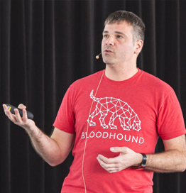
Getting out of HIM -2
Organization
Perform one ideal and close-to-perfect hunting and take note of all the steps taken
Formalize the process from the note above. Improve and adjust overtime
Documentation as a habit
Planning and Prioritization
Follow a framework or create your own (ps: it’s harder to create one)
Look inside on your organization first! Ask these question!
What is our crown jewels
What visibility and logs do we have
Severity and probability (CBA)
Do we have capability to deploy detection
Asses the framework against your organization security priority
Great talk on TH planning and prioritization using ATT&CK from my friend and mentor @ScoubiMtl SOC Counter ATT&CK - https://www.youtube.com/watch?v=j8MZJ1xU-3k

Slide 36
HIM -3
Disconnected Hunters

Slide 37
Who are they?
Have dedicated personnel(s), with the right tasks and skill set, and already have good organization, planning and prioritization in place.
But!
They are operating in “disconnected exclusive bubble”
They are good Threat Hunting teams that perform high quality research and push decent rules to the production, but that is the end of it!
No connection with the rest of SOC or security body in the organization!

Slide 38
With who?
There are multiple teams that can benefit from working with Hunt team (or the other way around)
Management
SOC Analysts and Incident Responder
Infrastructure and Architecture
Red Team/Vulnerability Assessment/Penetration Test
Risk Assessment and Threat Intelligence
Development Team

Slide 39
Getting out of HIM -3
Management
Show detection coverage progress (hunting value!)
Provide feedback on yearly plans
SOC Analysts and Incident Responder
Incident response training
Proper documentation for the detection they have built
FP initiatives
Infrastructure and Architecture
Identify logging gaps
Possible tools to be acquired
Recommend configuration changes
Red Team/Vulnerability Assessment/Penetration Test
Incorporate the other team engagements into Purple Teaming exercises,
Build detection on advance techniques that required proper offensive infrastructure
Risk Assessment and Threat Intelligence
Learn about crown jewels or threat intel report and perform hunting operation around it
Development Team
Learn on the application your company has developed so you can understand the logs easily,
Suggest improvement on logging function

Slide 40
HIM -4
Ignorant Hunters

Slide 41
Who are they?
Have dedicated personnel(s), with the right tasks and skill set, and already have good organization, planning and prioritization in place.
They also working with the other teams occasionally.
But!
They are ignoring lots of responsibilities during and after hunting and detection creation.
They are making lot of assumptions during the research phase.
Seeing that once something is covered you are all set for life! Lacking improvements and re-learning.

Slide 42
Ignorant Traits
Blind hunting with lot of assumptions
Using open source detection ideas blindly (not looking into their environment)
Not performing real emulation of the technique, fully assume detection will work
Assuming testing lab environment is the same as production environment
Ignoring that detection is an interconnected systems
No understanding of logging engineering concept (e.g. configuration, deployment, limitation, etc.)
No understanding of SIEM engineering concept (e.g. field mapping, parsing, computational limitation)
No continuous detection monitoring
No regular testing in certain points in the detection pipeline (e.g. RTA/ART)
No audit process such as FP rate or missing documentation
Assume nothing will ever go wrong
No improvement and learning
Too confident on the detection they have developed
See no point of redoing TTPs (if they are using MITRE ATT&CK)
Not taking effort to learn logging mechanism (e.g. talk to Development team to understand custom apps logs, talk to Network Security team to understand Firewall logs, etc.)

Slide 43
Getting out of HIM -4
Perform all the required tests
Emulation from start to the end until you can see the logs in the centralized production SIEM
Review open source detection before deployment (is it applicable, will there be lot of FP, etc.)
Make effort to understand the underlying technologies
Attend SIEM trainings or have some discussion with your infrastructure engineer
When a detection require some changes in the infrastructure, find out what is exactly the changes needed
Include automated testing framework in your pipeline
You’ll be able to verify when your detection is working or not
Test the whole pipeline (from source to pipeline to SIEM to detection engine to ticketing)
Assume that your detection will be bypassed by attacker
When you ran out of ideas start your hypothesis creation from your old detection
Ask question like “what if” or “imagine if”
Always pay attention on what’s going in the industry (e.g. follow conference presentation, new tools, etc.)

Slide 44
Closing

Slide 45
Threat hunting is not easy!
Known from community experience and HIM is created to educate you about it

Slide 47
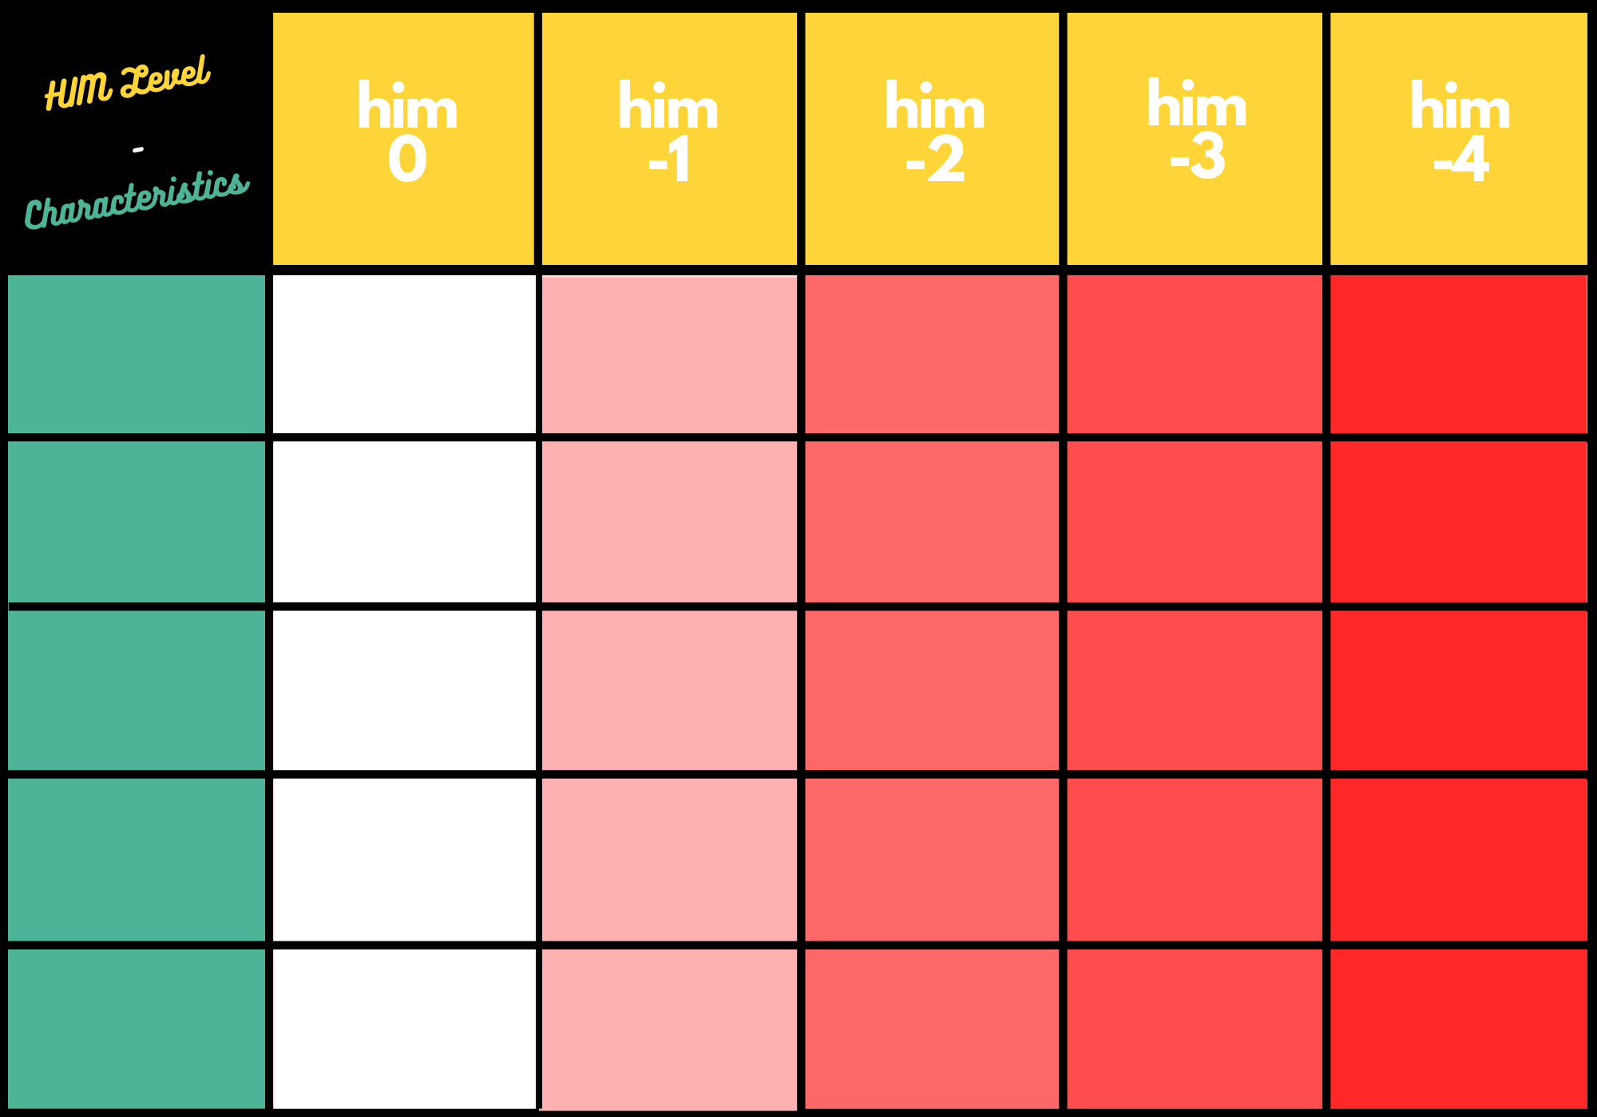
no hunters
hunters?
confused hunters
disconnected hunters
ignorant hunters
Dedicated hunting
personnel
No dedicated hunting personnel
At least one dedicated hunting personnel
At least one dedicated hunting personnel
Multiple dedicated hunting personnel
Multiple dedicated hunting personnel
Management understanding of threat hunting concepts
Small to no understanding of basic threat hunting concepts
Understand the basic and advanced principles of threat hunting. Experimenting with new methodologies.
N/A
Understand the basic principles of threat hunting
Understand the basic and advanced principles of threat hunting
Hunt organization, planning and prioritization capability
Bad organization, planning and prioritization
Able to achieve good organization, planning and prioritization
A “production line” with high level of organization, planning and prioritization
N/A
N/A
Integration with the rest of organization's security body
Work in silo, disconnected from the rest of the security body
Some collaborations on going here and there
N/A
N/A
N/A
Continuous improvement, deployment and learning
Big headed, no continuous improvement, deployment and learning
N/A
N/A
N/A
N/A

Slide 48
Utilize both HMM and HIM
Look for progresses to achieve and mistakes to avoid!
You can always learn from others’ experience ☺

Slide 49
Credits

Slide 50
Credits
My Employer
My Coworkers
SANS
SANS DFIR
David Bianco
Mathieu Saulnier
Olaf Hartong
Samir Bousseaden
Tony Lambert

Slide 51
Credits - Visual
Diagrams are made via canva[.]com
Slides template from slidehood[.]com

Slide 52
thanks for tuning in!
Twitter @tas_kmanager
LinkedIn /tondangmangatas/
GitHub /tas-kmanager/
My team’s Medium /@threathuntingteam/
Slides will be available on my GitHub

Slide 53
Appendix

Slide 54
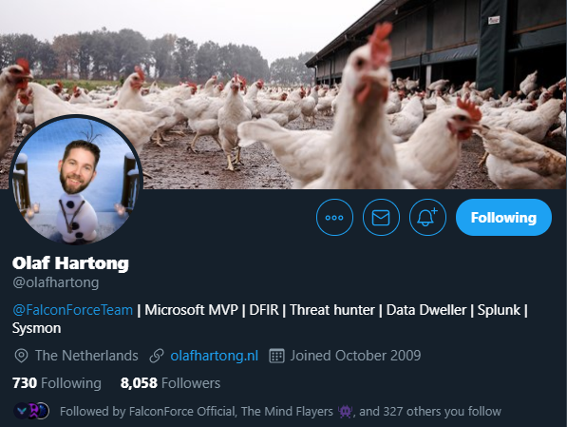
@olafhartong
Building a team because it’s a buzzword
Good analyst != Good threat hunter
Hunters with multiple roles (not dedicated)
No proper process on hunting follow up
Working in silo

Slide 55

@SBousseaden
Confidence on your own detection (lack of review process)
Not thinking of and involve in False Positive improvement process
Too much automation, human element is important in hunting

Slide 56
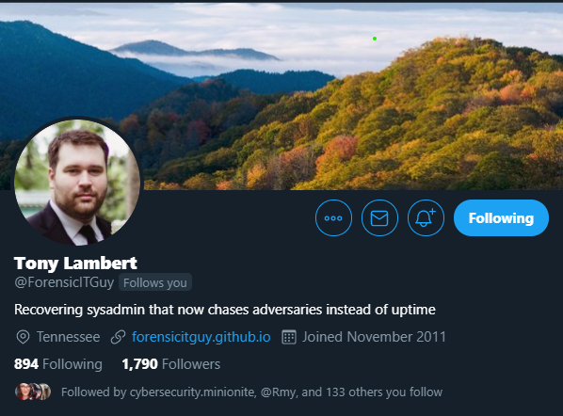
@ForensicITGuy
No feedback loop to learn and improve
Missing documentation on your own environment (known good)

Slide 57
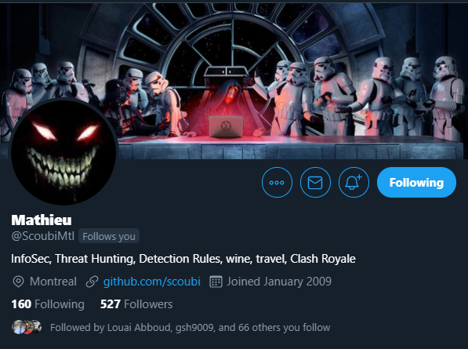
@ScoubiMtl
Dedicate time for hunting and respect it
Not every security person is a good Threat Hunter
When your hunt team do anything but hunting
Management thinking hunting is just a new buzzword and analyst can do it
Importance of metrics
Rely too much on a framework

Slide 58
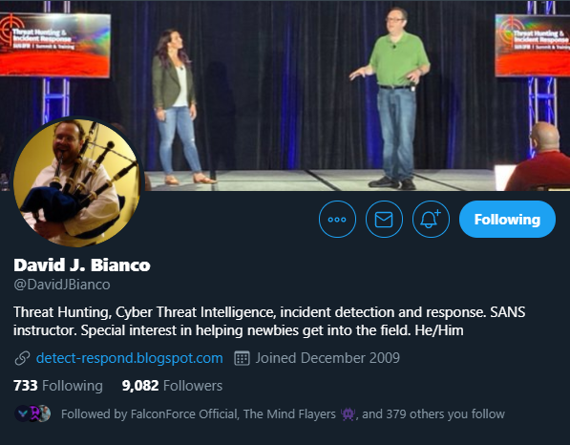
@DavidJBianco
Knowing when to start hunting program
Different understanding on the term of threat hunting, might cause miscommunication
The real purpose of threat hunting is not to find incidents! But rather as finding new ways to detect future intrusions
Notes:
08:00

